Slide 1
Software Quality Assurance and Testing
Lecture - 02
Harish Aggarwal

Slide 2
Quality Models

Slide 3
Re-Cap
Lecture - 01
Definitions – S/W Quality, S/W Quality Assurance
Importance of QA
Causes of Defects
Business Models in S/W
S/W Cost, Quality Cost
Quality culture

Slide 4
Agenda
Software Quality Models
McCall
IEEE 1061
ISO 25000 Series
Quality Requirements
Frameworks
ISO/IEC/IEEE 12207 - Software Life Cycle Processes
CMMI-Development
ITIL Framework

Slide 5
Quality Perspectives
Five quality perspectives as described by Garvin (1984) [GAR 84]
Transcendental approach to quality : Although I can’t define quality, I know it when I see it.
User-based approach : As expected from the user’s perspective. Can change with the expectations of each user
Manufacturing-based approach : A “process based approach”. Compliance with the process while defining the requirements and throughout the life cycle.
Product-based approach : Quality of internal properties of the software components, for example, the quality of its architecture, quality of code, etc
Value-based approach : Focuses on the elimination of all activities that do not add value.

Slide 6
Software Quality Model
Quality Model
A defined set of characteristics, and of relationships between them, which provides a framework for specifying quality requirements and evaluating quality. ISO 25000 [ISO 14a]
A software quality model can be is used to
Define software quality characteristics that can be evaluated;
Define quality characteristics that will serve as the non-functional requirements
Set a measure and its objectives for each of the quality requirements.

Slide 7
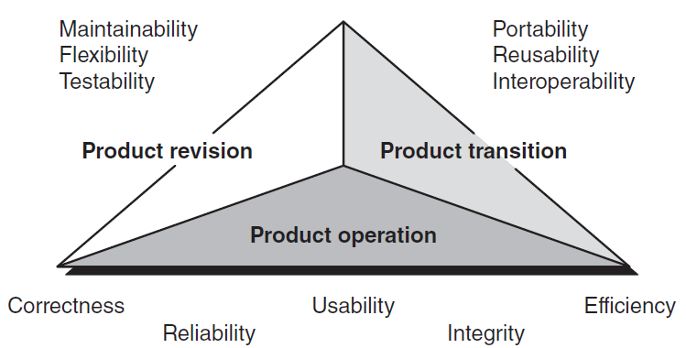
Quality Models –
McCall [MCC 77]
Proposed by McCall [MCC 77], developed in the 1970s for the United States Air Force and was designed for use by software designers and engineers
Uses Product based approach.
More on Internal Quality
Proposes three perspective for the user
Each perspective into Quality Factor
Quality Factor → Quality criteria (Measurable).

Slide 8
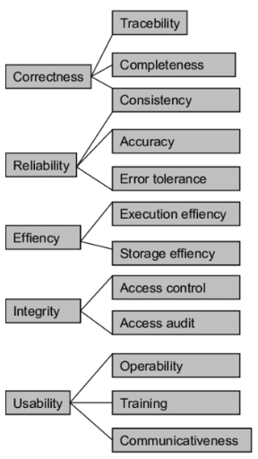
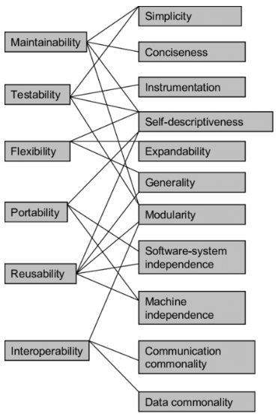
Quality Models –
McCall [MCC 77]

Slide 9
Internal Quality Vs
External Quality
A change request
External view –
How soon it can be implemented, and whether the requirement is fulfilled of not.
Internal View –
Effort to identify the change – Location and size.
Implementing the change
Testing the change
Documenting the change
Releasing the updated version

Slide 10
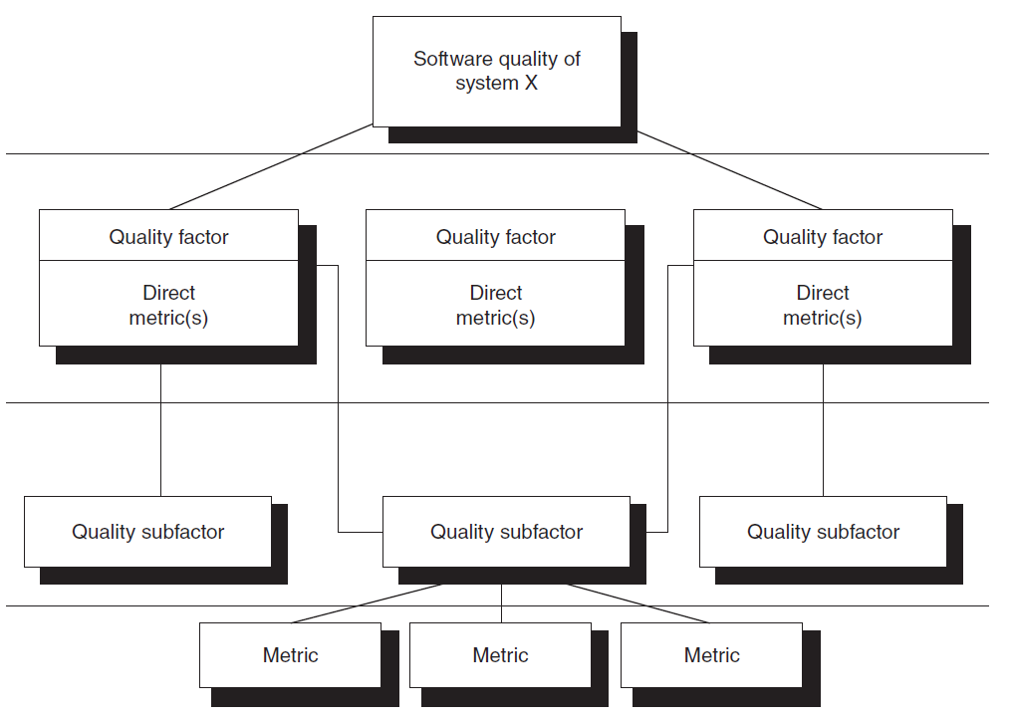
Quality Models –
IEEE 1061
1061-1998 - IEEE Standard for a Software Quality Metrics Methodology
Presents examples of measures without formally prescribing specific measures.

Slide 11
IEEE 1061
Stake Holders
The model provides defined steps for –
Software program acquisition. Measurements when adapting and releasing the software.
Software development – For designers and developers
Quality assurance/quality control/audit – For outside team to evaluate
Maintenance : While making changes or upgrades to software
Client/user – Allows User to State Quality characteristics and evaluate during user acceptance Test

Slide 12
IEEE 1061
Steps to be followed
Steps to be followed
List down non-functional quality requirements. Set a priority of these requirements
Meet every stakeholder
List down and resolve conflicts
Quantify each quality factor. Measure of threshold and quality.
Have thresholds approved.
Perform cost-benefit study – Take into account additional cost to enter information, automate calculations, interpret and present the results, to modify support software, for software assessment specialists, for specialized software to measure the software application, Training required to apply the measurement plan.
Have clear measurement method – Process of measurement, Data collection method, areas of S/W which needs to be measured, etc
Analyze Results – Analyze difference between measurements taken at different times and different environment.
Validate the measures - Identify measures that can predict the value of quality factors, which are numeric representations of quality requirements
Model recommends techniques to Validate Measures.

Slide 13
IEEE 1061
Adoption
Adoption hesitancy
Seen as being too expensive
Some did not see its usefulness
The industry was not ready to use it
Suppliers did not want to be measured in this way by their clients.
Thus the adoption was not too high and it was not too popular outside of Military

Slide 14
ISO 25000 Series
Introduction
The international standardization of a software quality model, the ISO 9126 standard [ISO 01], was published for the first time in 1991
Lots of terminology used from McCall [MCC 77] and IEEE 1061 [IEE 98b]
International Organization for Standardization
Replaced by the ISO/IEC 25000 standard [ISO 14a].
The ISO 25000 [ISO 14a] standard allows for the evaluation of the quality of the final software product as it
Assess the quality of the development process,
Assess the quality of the final product.
The ISO 25000’s series of standards recommends the following four steps [ISO 14a]:
Set quality requirements
Establish a quality model
Define quality measures
Conduct evaluations

Slide 15
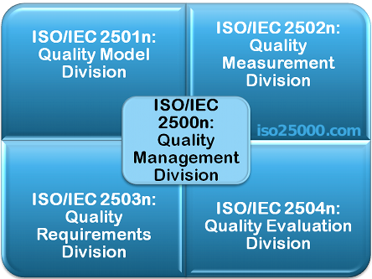
ISO 25000 Series
Introduction
ISO/IEC 25000 series of standards, is also known as SQuaRE (System and Software Quality Requirements and Evaluation)
A framework for the evaluation of software product quality

Slide 16
ISO 25000 Series
ISO/IEC 2500n – Quality Management Division
ISO/IEC 25000 - Guide to SQuaRE
ISO/IEC 25001 - Planning and Management
ISO/IEC 2501n – Quality Model Division
ISO/IEC 25010 - System and software quality models
ISO/IEC 25012 - Data Quality model
ISO/IEC 2502n – Quality Measurement Division
ISO/IEC 25020 - Measurement reference model and guide
ISO/IEC 25021 - Quality measure elements
ISO/IEC 25022 - Measurement of quality in use
ISO/IEC 25023 - Measurement of system and software product quality
ISO/IEC 25024 - Measurement of data quality

Slide 17
ISO 25000 Series
ISO/IEC 2503n – Quality Requirements Division
ISO/IEC 25030 - Quality requirements
ISO/IEC 2504n – Quality Evaluation Division
ISO/IEC 25040 - Evaluation reference model and guide
ISO/IEC 25041 - Evaluation guide for developers, acquirers and independent evaluators
ISO/IEC 25042 - Evaluation modules
ISO/IEC 25045 - Evaluation module for recoverability

Slide 18
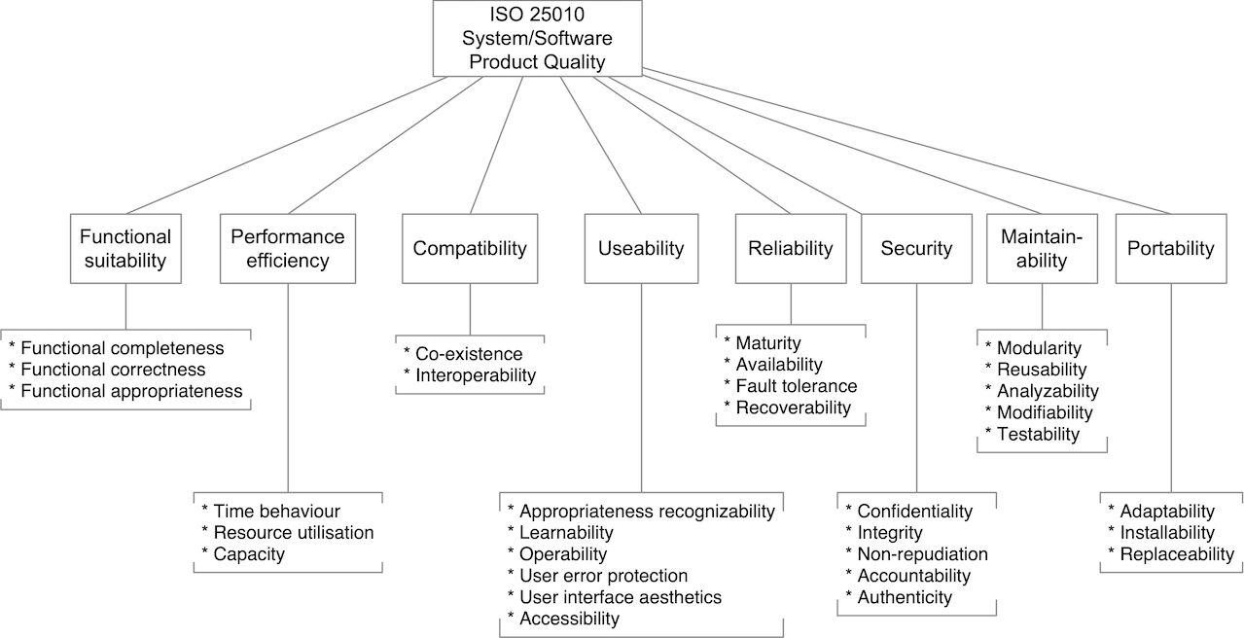
ISO 25010

Slide 19
Requirement - Defn
Functional Requirement
A requirement that specifies a function that a system or system component must be able to perform. ISO 24765 [ISO 17a]
Non-Functional Requirement
A software requirement that describes not what the software will do but how the software will do it. Synonym: design constraint. ISO 24765 [ISO 17a]
Performance Requirement
The measurable criterion that identifies a quality attribute of a function or how well a functional requirement must be accomplished. A performance requirement is always an attribute of a functional requirement. IEEE 730 [IEE 14]

Slide 20
Software Quality Requirements
In general, the requirements document form the basis of design and development of any product.
Steps for defining Requirements
Gather : collect all wishes, expectations, and needs of the stakeholders;
Prioritize : Prioritize based on relative importance of requirements (essential, desirable);
Analyze : Check for consistency and completeness of requirements
Describe : Can be easily understood by users and developers;
Specify : Transform the business requirements into software specifications
Category of Requirements –
Functional Requirements: Includes business and functional requirements for the user.
Non-Functional (Quality) Requirements: quality characteristics and sub-characteristics such as security, confidentiality, integrity, availability, performance, and accessibility.
Constraints : Limitations such as infrastructure on which the system must run or the programming language that must be used to implement the system.

Slide 21
Quality of Requirements
Good requirements should have following characteristics
Necessary : Prioritized list as per the objective of what needs to be achieved.
Unambiguous: Clear enough to be interpreted in only one way.
Concise: Precise, brief, and easy to read.
Coherent: Must not contradict the other requirements. Consistent terminology
Complete: Stated fully in one location and convey completeness, not requiring any other references.
Accessible: They must be realistic regarding their implementation in terms of available finances, available resources, and within the time available.
Verifiable: Should be verifiable whether they are met or not based on four possible methods - inspection, analysis, demonstration, or tests.
ISO 29148 or IEEE 830 is a complete section on Requirement engineering
https://www.iso.org/obp/ui/#iso:std:iso-iec-ieee:29148:ed-2:v1:en
https://standards.ieee.org/ieee/830/1222/

Slide 22
Software Quality Requirements
Quality requirements – Non functional requirements.
Should be well documented with details such as -
Quality characteristic, Quality sub-characteristic
Measure (i.e., formula)
Objectives (i.e., target)
Importance - “Indispensable”, “Desirable” or “Non-applicable.”
Steps suggested for defining non-functional requirements –
Identify stakeholders → Develop Questionnaire → Conduct Interview → Consolidate and prioritize results → Obtain consensus on quality factors
REQUIREMENT TRACEABILITY - Should be Traceable using documents such as –
Specifications document
Architecture and design document
Code, and
User Manuals

Slide 23
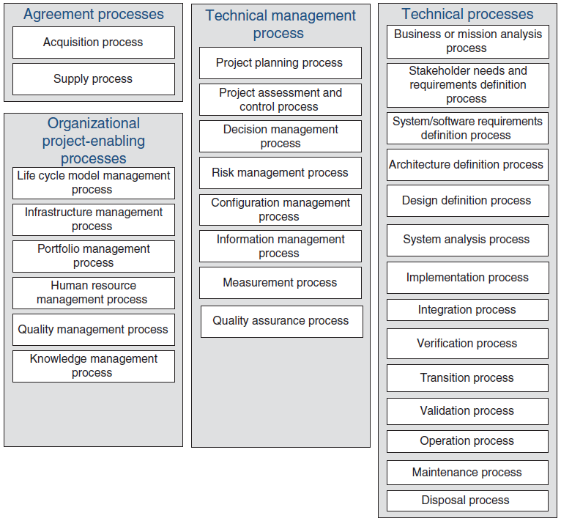
ISO/IEC/IEEE 12207
Software Life Cycle Processes
Establishes a common framework for software life cycle processes.
Each process has –
Title
Purpose
Outcome
Activities
Task

Slide 24
ISO/IEC/IEEE 12207
QA Process in Detail
Title – The Quality Assurance Process
Purpose
To help ensure the effective application of the organization’s quality management process to the project.
QA focuses on providing confidence that quality requirements will be fulfilled. Proactive analysis of the project life cycle processes and outputs is performed to assure that the product being produced will be of the desired quality and that organization and project policies and procedures are followed.
Outcome
Project QA procedures are defined and implemented.
Criteria and methods for QA evaluations are defined.
Evaluations of the project’s products, services, and processes are performed, consistent with quality management policies, procedures, and requirements.
Results of evaluations are provided to relevant stakeholders.
Incidents are resolved.
Prioritized problems are treated.

Slide 25
ISO/IEC/IEEE 12207
Activities & Task
Prepare for QA.
Define a QA strategy.
Establish independence of QA from other life cycle processes.
Perform product or service evaluations.
Evaluate products and services for conformance to established criteria, contracts, standards, and regulations.
Monitor that verification and validation of the outputs of the life cycle processes are performed to determine conformance to specified requirements.
Perform process evaluations.
Evaluate project life cycle processes for conformance.
Evaluate tools and environments that support or automate the process for conformance.
Evaluate supplier processes for conformance to process requirements.
Manage QA records and reports.
Create records and reports related to QA activities.
Maintain, store, and distribute records and reports.
Identify incidents and problems associated with product, service, and process evaluations.

Slide 26
ISO/IEC/IEEE 12207
Activities & Task
Treat incidents and problems. This activity consists of the following tasks:
Record, analyze, and classify incidents.
Identify selected incidents to associate with known errors or problems.
Record, analyze and classify problems.
Identify root causes and treatment of problems where feasible.
Prioritize treatment of problems (problem resolution) and track corrective actions.
Analyze trends in incidents and problems.
Identify improvements in processes and products that may prevent future incidents and problems.
Inform designated stakeholders of the status of incidents and problems.
Track incidents and problems to closure.

Slide 27
IEEE 730 for SQA Processes
Establishes the requirements for the planning and implementation of SQA activities for a software project (https://www.yegor256.com/pdf/ieee-730-2014.pdf)
The IEEE 730 is structured as follows :
Clause 1 - Describes the scope, purpose and an introduction.
Clause 2 - Identifies normative references used by the IEEE 730.
Clause 3 - Defines the terms, abbreviations and acronyms.
Clause 4 - Describes the context for the SQA processes and SQA activities, and covers expectations for how this standard will be applied.
Clause 5 - Specifies the processes, activities and SQA tasks. Sixteen activities grouped into three categories are described: implementation of SQA process, product assurance, and process assurance.
Twelve informative annexes A–L, where annex C provides guidelines for creating a SQAP.

Slide 28
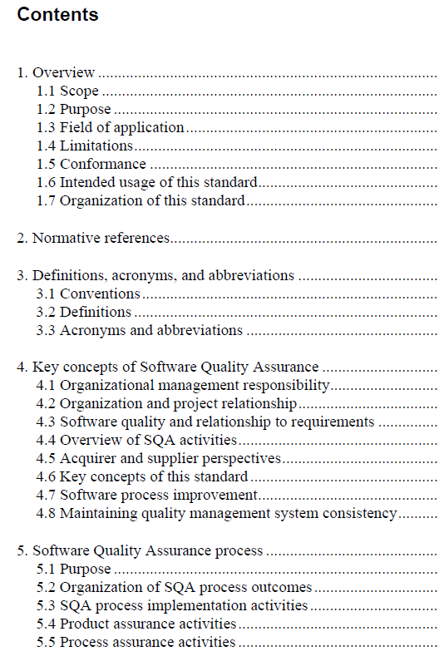
IEEE 730 for SQA Processes

Slide 29
Thank You

